Slide 1
CHEM/BIOL 667: Class Projects
12.7.21
This material is based upon work supported by the NSF under Grant No. DBI-1548297.
Disclaimer: Any opinions, findings and conclusions or recommendations expressed in this material are those of the authors and do not necessarily reflect the views of the National Science Foundation.

Slide 2
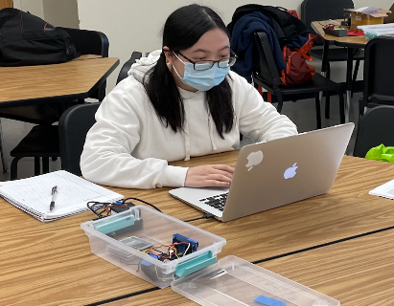
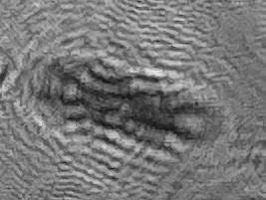
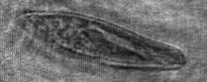
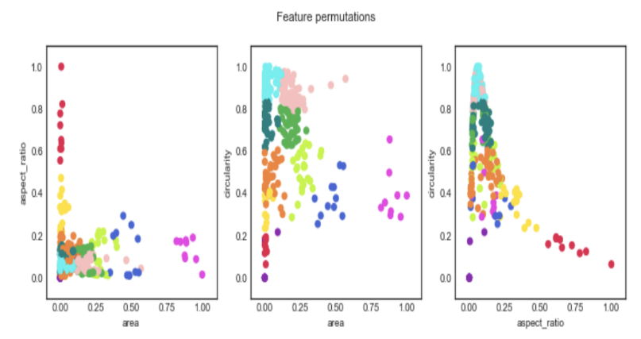
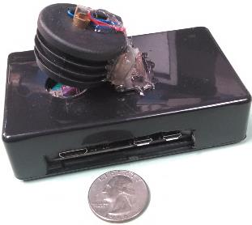
CHEM/BIOL 667: Optical Engineering for the Biological Sciences
100 um
Reconstruct
Feature Analysis

Slide 3
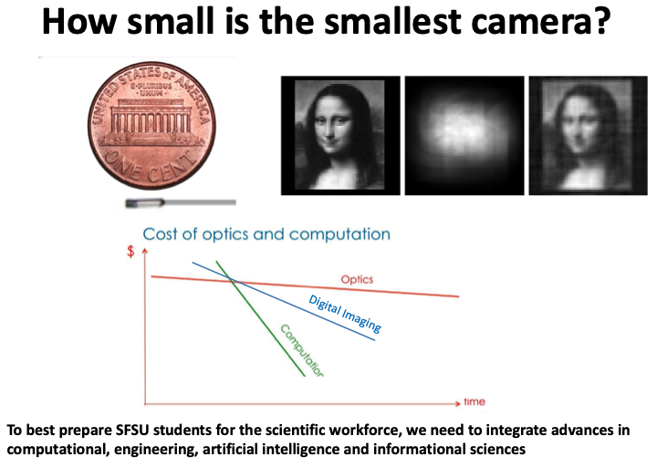

Slide 4
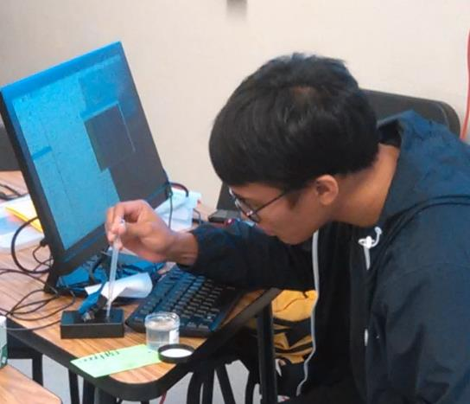
Course Goals
Develop a course-based undergraduate research (CURE) platform that teaches engineering concepts and real-world programming skills to students in the biological sciences (adaptable nationwide)
Engage students in a real research project
Selected CCC enabled Learning Objectives
Develop an engineering mindset
Work in multidisciplinary research
Project-based learning (CURE course)
Foster “frugal” science
Build a digital holographic microscope
Concept-to-Construct experience
Develop science communication skills

Slide 5
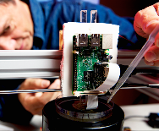
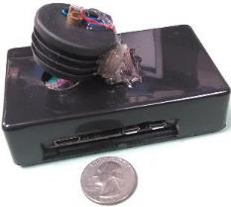
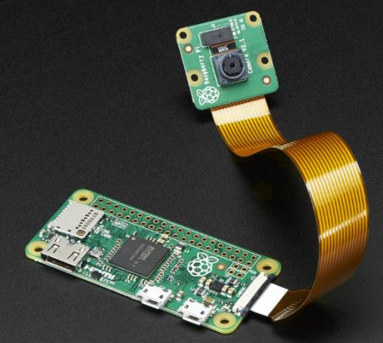
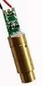
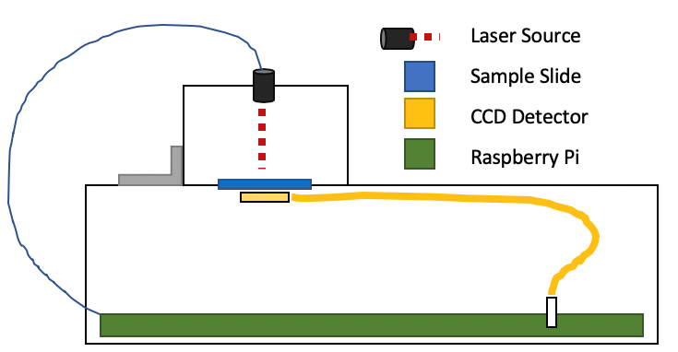
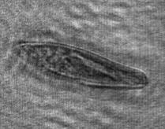
Digital In-line Holographic Video Microscope
Image
Sensor
LASER
5 Mpix Image Sensor
1080p Video 30 FPS
3.7 mm x 2.7 mm
1.4 um pixel
Red Laser
$3
$0.30
HDMI USB 5v
Raspberry Pi Zero W
$10
Red Laser
Sample
Image Sensor
Pi Zero W
ARM Processor
Linux OS, Python, OpenCV
HDMI Output
Original Hologram
Reconstructed Image
Tom Zimmerman, CCC partner IBM Research Almaden
https://www.ted.com/speakers/tom_zimmerman
376 μm
Paramecium

Slide 6
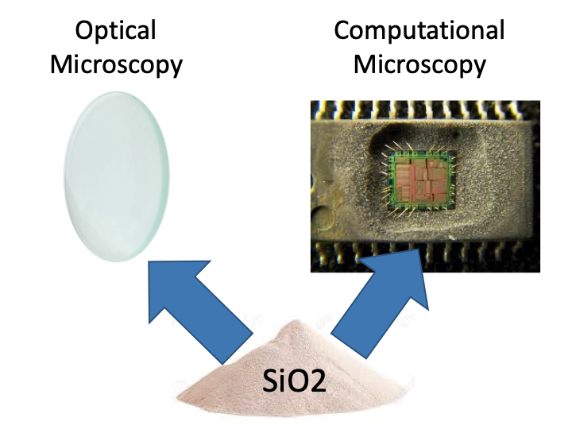
2

Slide 7
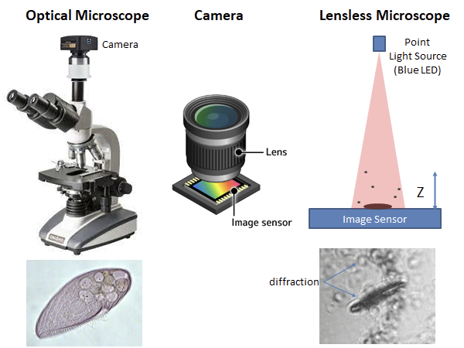
focus
100 um

Slide 8
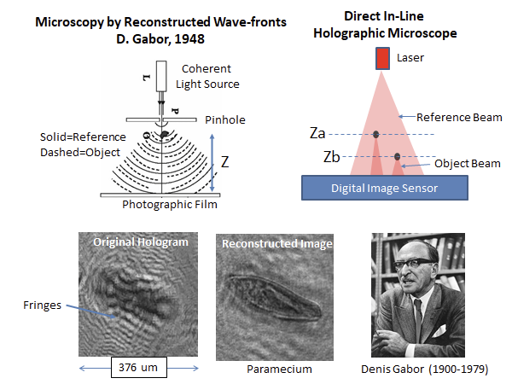
z=1.7 mm

Slide 9
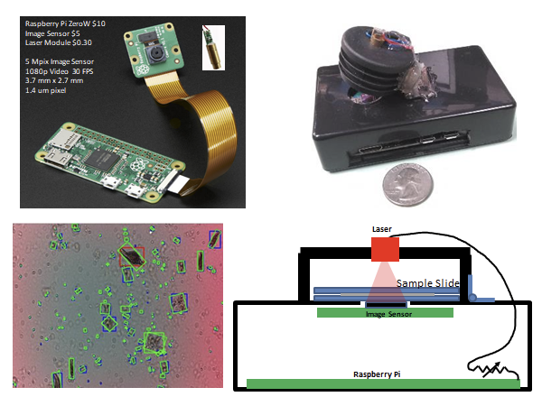
2.7 mm
3.7 mm

Slide 10
Optimizing Magnification and Resolution of the Holographic Microscope
Jiayu Luo

Slide 11
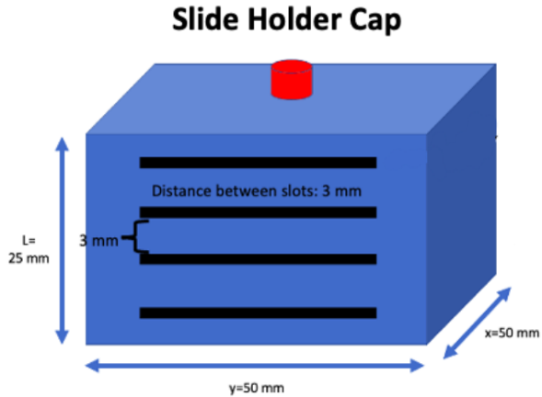
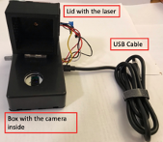
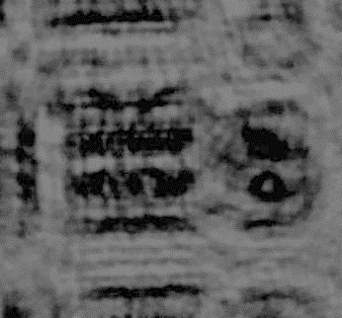
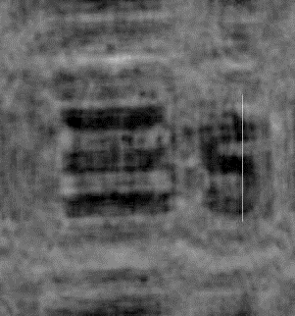
B
Goal: Determine and improve microscope magnification and resolution.
Method: Place USAF Resolution Test Chart slide at several locations above image sensor and measure magnification and resolution using the “streamRecoLine” program.
Raw image (left) and reconstructed image (right)

Slide 12
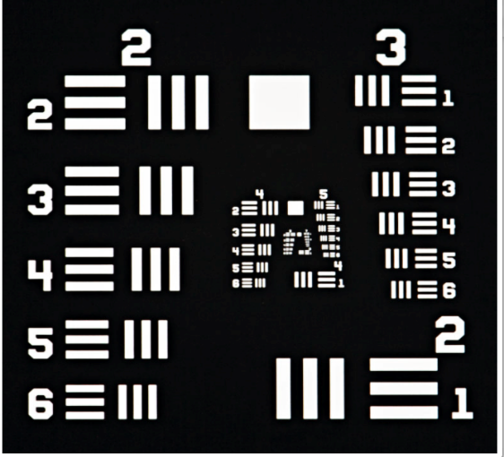
The images were captured by the pi image sensor extracted from a pi camera and reconstructed using the python file “stremRecoLine”.
Use USAF slide to determine microscope magnification and resolution.
Magnification: Compared the true width of a USAF line (horizontal bar in group 5 element 4) with the image width measured in pixels (1 pixel = 1.4 um) using the “full width at half-maximum” (FWHM) method.
Resolution: Find the last resolvable line in the USAF target to determine the resolution. Reconstruct and use ImageJ to measure contrast.
USAF Resolution Test Chart Slide

Slide 13
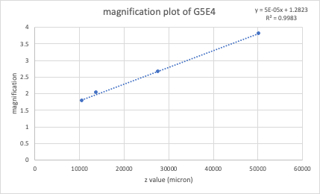
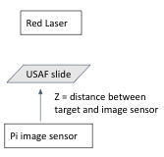
Magnification is proportional to the
object-to-image sensor distance.
Magnification versus object-to-image sensor distance Test setup

Slide 14
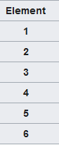
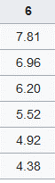
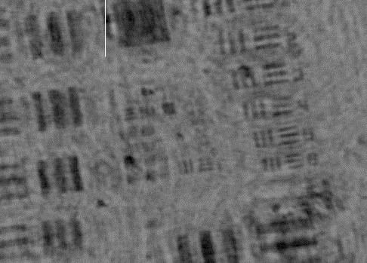
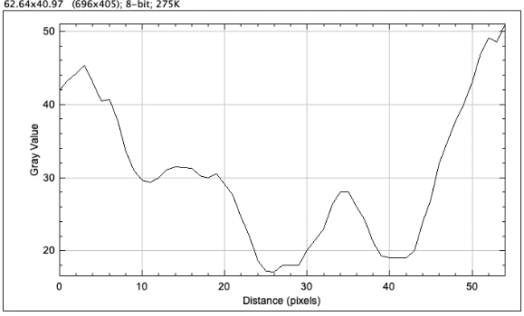
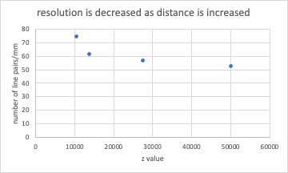
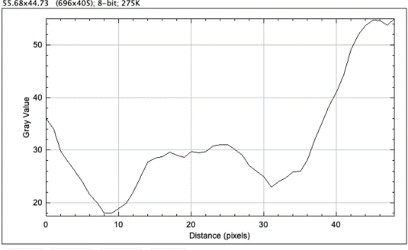
Resolution
Line Width (um)
Pixel Intensity Values Across Line
Group 6
Vertical G6E2 Line Contrast
Figure 6. Reconstructed image of USAF slide.
Contrast plots of the vertical elements in G6E2 (top) and G6E3 (bottom).
Horizontal G6E2 Line Contrast

Slide 15
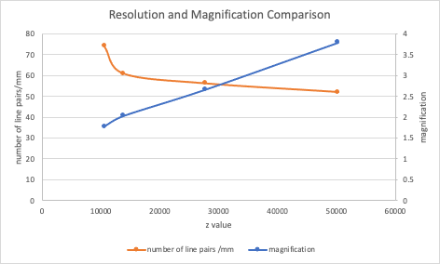
Summary and Future Directions
Future directions
Reduce background noises
Reduce laser wavelength
Use pinhole to increase coherence
Maximum resolution is 6.2 μm!

Slide 16
Auto-Reconstruction
Biviana Ochoa

Slide 17
Problem
Holographic microscope images require Z location of object to perform mathematical reconstruction.
Manually reviewing reconstructed images is tedious and time consuming (e.g., 150 images for range of 0 to 3000 um at 20 um steps)
Solution
When a reconstructed object is in focus it typically is darker than its unreconstructed image.
Collect reconstructions at large Z intervals (e.g., 500 um, 6 images for range of 0 to 3000 um)
Create a composite image from reconstructions by selecting the darkest pixel from each reconstructed image.

Slide 18
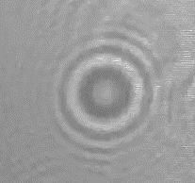
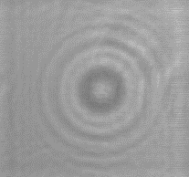
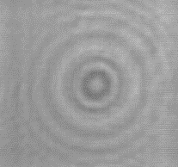
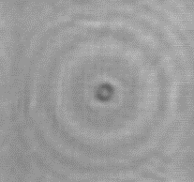
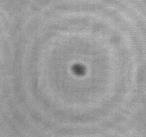
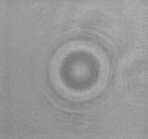
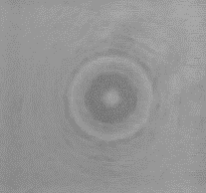
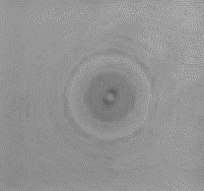
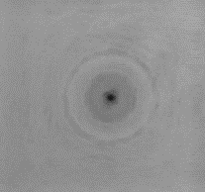
Build composite image by selecting
darkest pixel from each reconstruction
rawIM
z = 1000
z = 2000
z = 3000
z = 4000
RECONSTRUCTED
Darkest Pixel
Darkest Pixel
Darkest Pixel
Darkest Pixel
Darkest Pixel
COMPOSITE
Formation of Composite Image
Final Composite Image!

Slide 19
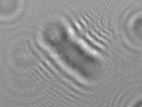
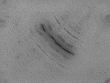

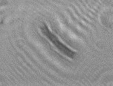
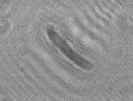
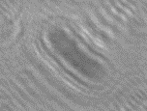
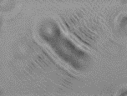
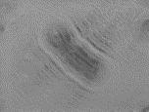
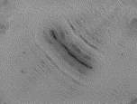
Create Composite Image
rawIM
z = 1000
z = 2000
z = 3000
z = 4000
RECONSTRUCTED
Darkest Pixel
Darkest Pixel
Darkest Pixel
Darkest Pixel
Darkest Pixel
COMPOSITE
Formation of Composite Image
Final Composite Image!

Slide 20
Automated Training Data Generation
Oskar Garcia

Slide 21
Problem:
For good classification performance, machine learning algorithms requires many views of an object. If only one image is available, synthetic data augmentation is sued where the original image is stretched, skewed, enlarged, reduced and rotated.
Solution:
Automatically create a training set of images comprised of multiple real image of objects in a variety of poses and orientations.
Method:
Record a movie of plankton swimming.
Detect plankton in each frame
Track plankton, maintaining ID across frame boundaries
Measure aspect ratio and orientation of each object.
Save an image of an object when it’s aspect ratio or orientation changes.

Slide 22
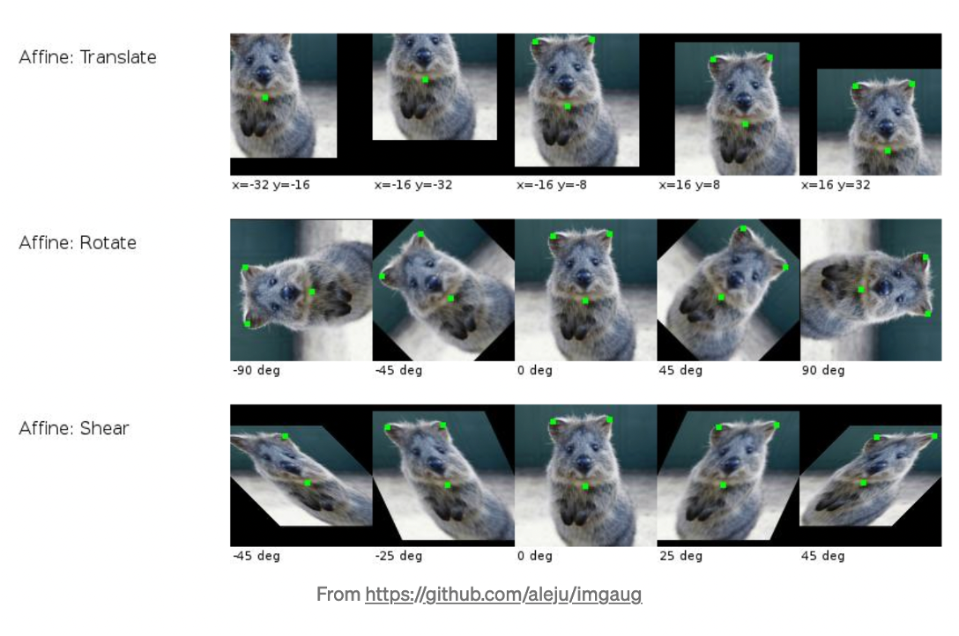
Synthetic Data Augmentation

Slide 23
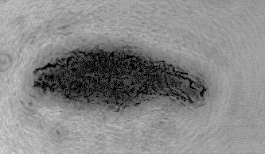




Image Processing Pipeline
Detect
Detect objects in frame
Track
Maintain object ID across frames
Capture
Save salient images

Slide 24


Synthetic
Augmentation
Real
Augmentation

Slide 25
Future work
• Make detector more selective of desired objects
• Extract object morphological (shape) features
• Use features to train machine learning classifiers

Slide 26
Developing a Graphical User Interface (GUI) to Improve Image Detection
Salma Ahmed
1st Year MS in Chemistry

Slide 27
Problem:
Holographic images and videos need to be reconstructed for proper viewing. This requires the adjustment of several parameters including image blurring, binary quantization threshold, and selection of minimum and maximum of detected object area. The current software requires a sequence of keystrokes to vary these parameters.
Solution:
Create a mouse-driven graphical user interface (GUI) so users can adjust sliders to change image processing parameters. Include method to save and name reconstructed images, video clips and detection files.

Slide 28


Previous detect program uses key functions to adjust image processing parameters
threshold
maximum area
minimum area
Keyboard functions to change image quantization threshold, minimum and maximum of detected object area.
Notes:
Layout: how the script works, prior art, shortcomings, my solutions, demo
Explanation: color -> grayscale -> threshold level (demonstrate with hands)

Slide 29
Next Steps
Get the programs work on a Mac
Combine the image and video detect programs to one big program
Add a “play bar” in the video detect program so the user can rewind/fast forward in the video
Convert the program to an executable program or an ImageJ plug-in

Slide 30
Classifying Different Plankton Organisms
Lela Legesse

Slide 31
Goal:
Collect plankton samples in the field. Contain them within the microscope to detect, extract features and classify.
Method:
Build a plankton collection net.
Use net to collect samples in the field.
Purchase and modify plastic mesh with grid size similar to image sensor dimensions (2.7 x 3.7 mm)
Place collected plankton on grid and image to evaluate grid.

Slide 32



Plankton Net

Slide 33



Plastic Grid to Contain Samples

Slide 34












RAW BLUR BIINARY QUANTIZE
Image Processing Pipeline
CaptureRaw Image
Blur
Binary Quantize
Blurring image removes object texture that could otherwise create holes in object image when binary quantized

Slide 35
Future Directions
Create a better grid that is slightly smaller than the image sensing area to keep objects in field of view.
Scatter plot Aspect Ratio vs Area to classify objects.

Slide 36
Sonifying Critters
Ariana Nagainis

Slide 37

What is data sonification?
Sonifying data means mapping image and object features into sound structures
Example image data sets include planetary orbits, earthquakes, and biosignals.
Violins - optical light
Xylophone - x-ray light
Piano - infrared light
Harmony of gas, dust, and stars!
NASA, K. Arcand, M. Russo, A. Santaguida

Slide 38



Why sonify data?
Provide access to microscopy to those with visual impairments
New way to interpret data - hear patterns that are visually difficult to detect
Improve science communication among those with limited science literacy
Detect plankton in the field when monitor or laptop is not practical due to glare from sun and water damage to electronics.
Notes:
monitors in the sun hard to read - don’t want to pull out your computer and get it wet on a boat. You can move around the boat and do various things while listening to the data. hands and eyes busy dropping down a monitor in the water. Possibly you want to hear the density of plankton to know when to stop monitor.

Slide 39

Lets play music!
Large area - lower pitch
Smaller area - higher pitch
Notes:
I will play a video and my code will go frame by frame and play notes depending on the area of the moving critters. Larger area of moving object will play a lower pitch and the smaller the area, it will be a higher pitch. So let me show you!

Slide 40


Future Directions
Sonification of plankton movement using pitch mesh pairs
Sonification of Fish Movement Using Pitch Mesh Pairs, 2015
Andrew Mercer-Taylor, Columbia University, aan Altosaar, Princeton University
International Conference on New Interfaces for Musical Expression
Notes:
split in the road for artistic and data sonification. can you listen to the audio and predict how many critters, and where located. Taking sensor down sea and stop at depth where there is a lot of noise.

